Slide 1
Maritime Performance Analytics & Sea-Route Risk Assessment
•Internship Project at Flipkart Pvt. Ltd
•Presented by: Vajja Sri Nikitha
•Date:-20-1-2026

Slide 2
Project Overview
Goal: To build an end-to-end pipeline that integrates ship specs, navigation, weather, and fuel data.
Key Focus Areas:
  Analyzing weather impact on vessel speed.
  Optimizing fuel consumption vs. load weight.
  Assessing sea-route risks based on environmental conditions.

Slide 3
Data Integration
Process: Integrated 5 isolated datasets (Specifications, Navigation, Environment, Fuel, and Maintenance).
The Master Dataset: Created a unified maritime_master_dataset.csv for row-level correlation.
Tool Stack: Python, Pandas, Seaborn, Matplotlib

Slide 4
Datasets Used
•Ship / Submarine Specifications
• Navigation Logs
• Environmental Conditions
• Fuel Consumption Logs
• Maintenance & Incident Records

Slide 5
Sea-Route Risk Assessment
•Environmental risk (waves, wind, storms)
• Navigation difficulty
• Historical incidents
• Routes classified as:
• Low Risk
• Medium Risk
• High Risk

Slide 6
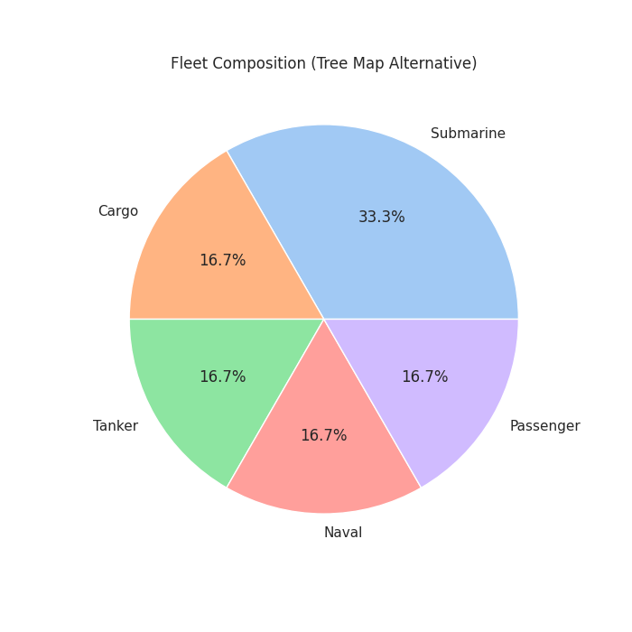

Slide 7
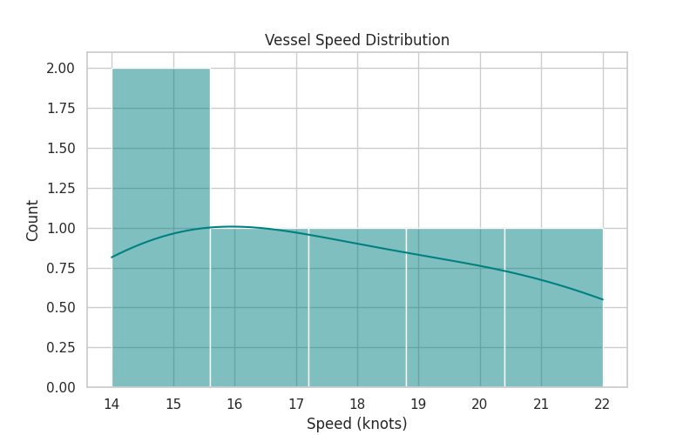

Slide 8
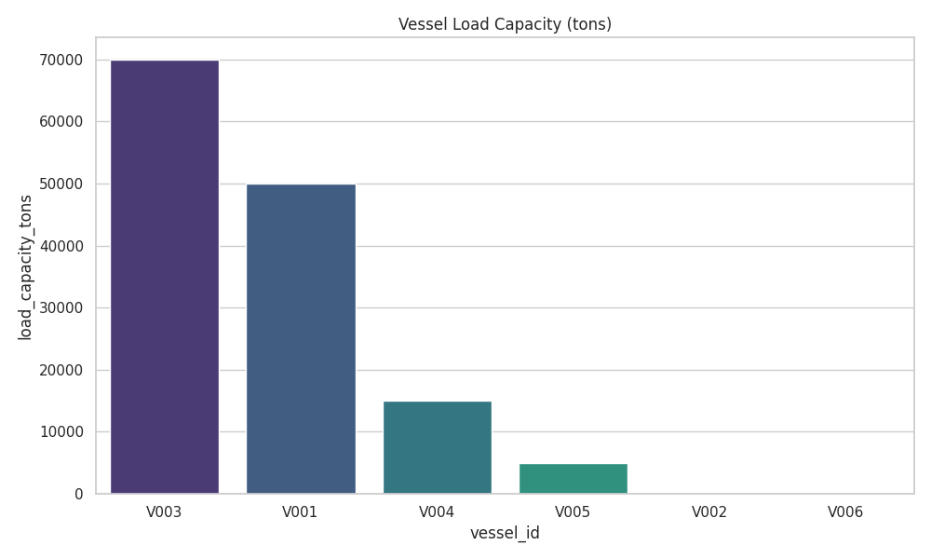

Slide 9
Key Results & Insights
Weather Sensitivity
Fuel vs. Load
Maintenance Burden
Tactical Safety

Slide 10
Conclusion
This project analyzes maritime vessel performance and sea-route risks using integrated marine datasets. By combining navigation, environmental, fuel, and maintenance data, key performance and risk indicators were calculated. The analysis shows how weather conditions, fuel usage, and vessel operations impact efficiency, delays, and route safety. The developed models help identify fuel-efficient operations, high-risk routes, and maintenance-prone vessels. Overall, the project demonstrates how data analytics can support better decision-making in maritime operations without using machine learning.

Slide 11
THANKYOU

